Slide 1
Microsoft Dynamics AX 2012 Administration Workshop Chapter 5: Model Management and Code Deployment
Presenter Name
Presenter Title
Presenter Company

Slide 2
Conditions and Terms of Use
Microsoft Confidential
This training package is proprietary and confidential, and is intended only for uses described in the training materials. Content and software is provided to you under a Non-Disclosure Agreement and cannot be distributed. Copying or disclosing all or any portion of the content and/or software included in such packages is strictly prohibited.
The contents of this package are for informational and training purposes only and are provided "as is" without warranty of any kind, whether express or implied, including but not limited to the implied warranties of merchantability, fitness for a particular purpose, and non-infringement.
Training package content, including URLs and other Internet Web site references, is subject to change without notice. Because Microsoft must respond to changing market conditions, the content should not be interpreted to be a commitment on the part of Microsoft, and Microsoft cannot guarantee the accuracy of any information presented after the date of publication. Unless otherwise noted, the companies, organizations, products, domain names, e-mail addresses, logos, people, places, and events depicted herein are fictitious, and no association with any real company, organization, product, domain name, e-mail address, logo, person, place, or event is intended or should be inferred.
Copyright and Trademarks
© 2013 Microsoft Corporation. All rights reserved.
Microsoft may have patents, patent applications, trademarks, copyrights, or other intellectual property rights covering subject matter in this document. Except as expressly provided in written license agreement from Microsoft, the furnishing of this document does not give you any license to these patents, trademarks, copyrights, or other intellectual property.
Complying with all applicable copyright laws is the responsibility of the user. Without limiting the rights under copyright, no part of this document may be reproduced, stored in or introduced into a retrieval system, or transmitted in any form or by any means (electronic, mechanical, photocopying, recording, or otherwise), or for any purpose, without the express written permission of Microsoft Corporation.
For more information, see Use of Microsoft Copyrighted Content at http://www.microsoft.com/about/legal/permissions/
Microsoft®, Microsoft Dynamics®, and SQL Server® Windows®, and Windows PowerShell® are either registered trademarks or trademarks of Microsoft Corporation in the United States and/or other countries. Other Microsoft products mentioned herein may be either registered trademarks or trademarks of Microsoft Corporation in the United States and/or other countries. All other trademarks are property of their respective owners.

Slide 3
Students: How to View this Presentation
Switch to Notes Page view
Click View on the ribbon and select Notes Page
Use page up or page down to navigate
Zoom in or out as needed
Most slides will have supporting text that you can view now or after the delivery
Add notes to your copy of the presentation if you want to
You take the presentation files home with you.

Slide 4
Overview
This chapter will give you an overview of:
The model store architecture
How to manage models and the model store
Code deployment options and best practices

Slide 5
Objective
After completing this chapter, you will be able to:
Discuss the model architecture
Discuss each model component
Discuss the model store uses
Review the steps for:
Creating
Exporting
Listing
Deleting models
Discuss code deployment process
Review code deployment best practices

Slide 6
Introduction
The model store is a collection of tables in the Microsoft Dynamics AX database that stores application metadata.
The model store replaces the application files that were used in earlier releases of Microsoft Dynamics AX.
Administrators will typically interact with models and the model store using Windows PowerShell commands.

Slide 7
Model Store Location
Microsoft Dynamics AX 2009
Microsoft Dynamics AX 2012
Microsoft Dynamics AX 2012 R2
AX Business DB
File Share
AX DB
AX DB
Business Logic
- aod files
- label files
User Data
User Data
User Data &
AX Model DB
Business Logic
Business Logic
AOS
AOS
AOS
Notes:
In earlier versions of Microsoft Dynamics AX, the Setup program installs deployment files, such as the application (AOD) and label (ALD) files on a file share. In Microsoft Dynamics AX 2012, the application file share is no longer required. The application files on the application share are organized and moved to different containers, as described in the following list:
The former content of the AOD files is now stored in a model store in the Microsoft Dynamics AX database.
The ALD files are stored in the model store in the Microsoft Dynamics AX database.
The Help files are stored on, and rendered by, the Help server.
Static files are either moved to the file system in the Application Object Server (AOS) instances, or converted into standard Application Object Tree (AOT) resources.
Microsoft Dynamics AX 2012 uses a single database for the business data and the model store. In Microsoft Dynamics AX 2012 R2, the model store and business data are split into separate databases. If the name of the business database is MicrosoftDynamicsAX, then the name of the model database is MicrosoftDynamicsAX_model.

Slide 8
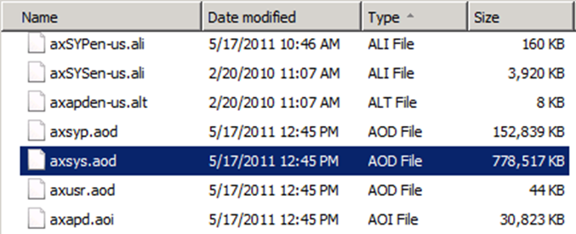
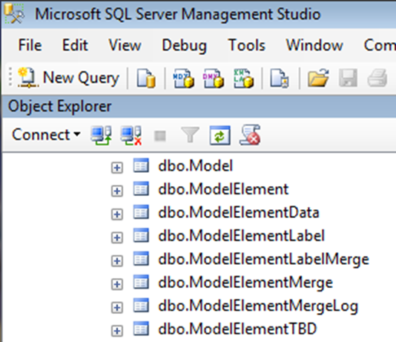
Model Store Location
Microsoft Dynamics AX 2009:
AOS maintains connection to application file share.
Microsoft Dynamics AX 2012:
Database stores master copy of code in model tables.
AOS copies code to local server on startup if local files require updates.
Notes:
The main benefits of moving to a SQL Server based model store are as follows:
Partners can fully leverage the SQL Server capabilities and tools.
Cross-reference queries are faster.
Label files are moved to the database and integrated with model data.
Maintenance, including backup and recovery, is simplified.
Richer tracing and diagnostic capabilities.
Model Store Tables
Below are the main tables in the Microsoft Dynamics AX database related to models:
Model: This table holds a list of all the models in the model store.
ModelManifest: This table holds the properties of a model. Example: It will give users the model ID, model name, the build number, and if the model was signed.
ModelElements: This table lists elements in Microsoft Dynamics AX and certain information about the element, such as the name, element type, what layer it is in, and to which model it belongs.
ModelElementlabel: This table lists the labels in Microsoft Dynamics AX and certain information about the label, such as the text of the label, the layer and model it is in, and the language it is for.
Layer: This table lists the layers in Microsoft Dynamics AX and their ID.
ModelGroup: This table lists models that overlap through conflicts.

Slide 9
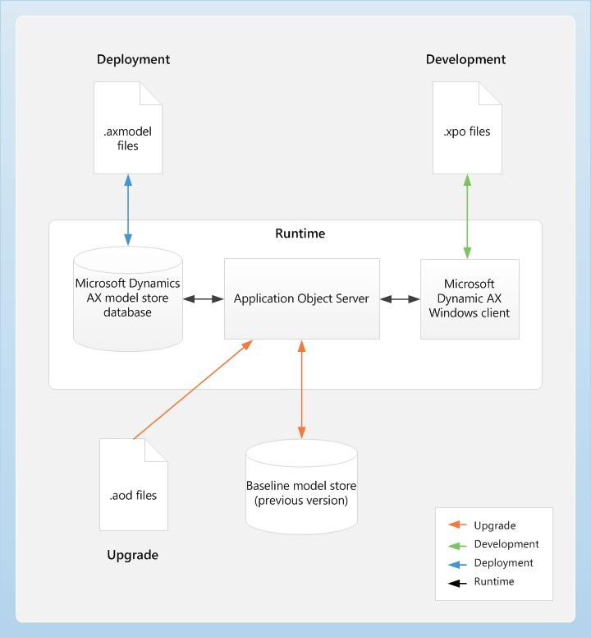
Model Store Uses
Notes:
Model Store Uses
The model store in Microsoft Dynamics AX 2012 is used in the following ways:
Installation: During the installation, the Setup program uses the dynamic link library axutillib.dll to import the .axmodel files from the installation path to the model store.
Upgrade: During an upgrade, the application (AOD) files from the earlier version are imported into the Microsoft Dynamics AX 2012 model store and into the old model store. The model store contains the new model, and the old model store contains the old model. The old model store mimics the old folder where the earlier version of Microsoft Dynamics AX stored the application files that were to be replaced.
Development environment: In the development environment, the developers can continue to use the .xpo files to export and import their code. The .axmodel is the preferred deployment artifact. Use the .axmodel files to migrate application elements from one environment to another, such as the development environment to the test environment. Export models to the .axmodel files out from the source system and import the .axmodel file into the target system.
Runtime: At runtime, the AOS retrieves the application elements, such as forms, reports, and classes from the model store to respond to client requests.
The figure on the slide above provides an overview of the model store architecture.
Baseline Model Store
The baseline model store replaces the "old" directory within the application directory in earlier versions of Microsoft Dynamics AX.
The baseline model store is an inactive model store that allows a programmer to compare previous code lines to the current active code line.

Slide 10
Model Definitions
Model element: Smallest entity that can be stored in a model.
Model: Logical partitions of elements in a layer.
Model store: A collection of tables in the Microsoft Dynamics AX database that stores application metadata.
Model file: The export of a model. The file extension is .axmodel.
Model store file: The export of an entire model store. The file extension is .axmodelstore.
Notes:
Models, Model Store, and Model Files
A model is a logical grouping of elements in a layer. An element can exist in exactly one model in a layer. Examples of elements include a table or class. The same element can exist in a customized version in a model in a higher layer. Models are identified by a name and a publisher and have a set of properties that can be modified, including a version number.
New models are easy to create. Models can be exported, installed, or uninstalled from the model store.

Slide 11
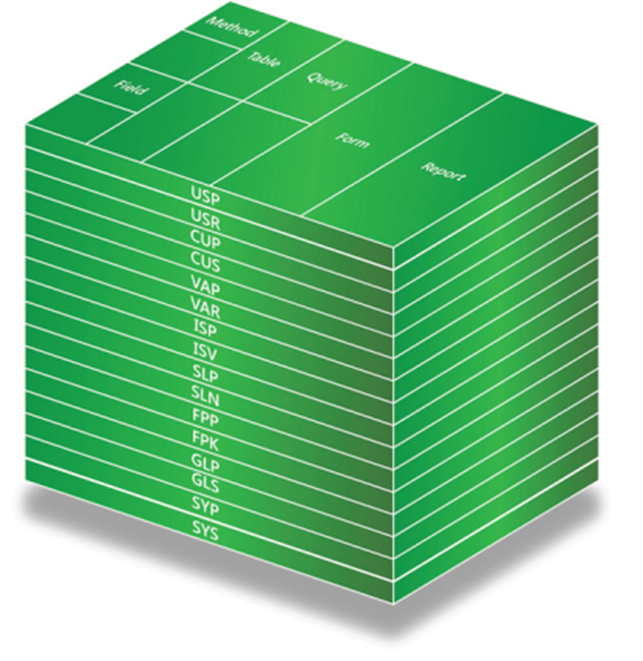
Layering Architecture
Microsoft Dynamics AX 2012 uses layers.
There are eight base layers and eight patch layers.
A model exists within a layer.
Notes:
The model store is the portion of the Microsoft Dynamics AX database where all Microsoft Dynamics AX application elements are stored, including customizations.
Layer and model information are integral parts of the model store. The Application Object Server (AOS) has access to the model store, handles layer-flattening, and provides model data to all the Microsoft Dynamics AX sub-systems, such as form- and report-rendering and X++ code.

Slide 12

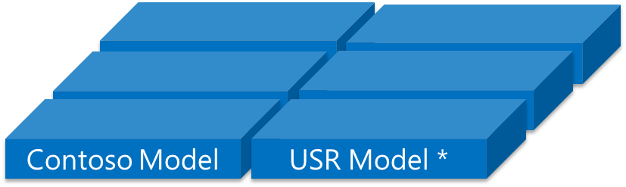
Models as Object Containers
Microsoft Dynamics AX 2009 (top graphic):
Controls elements at the layer level
Microsoft Dynamics AX 2012 (bottom graphic)
Multiple models, per layer
Control elements at model level
USR Layer
USR Layer
Notes:
Microsoft Dynamics AX contains sixteen layers:
Each layer consists of one or more logical parts called models.
A system-generated model exists for each layer. For example, the VAR Model is the system generated model for the VAR layer.
The system-generated models allow you to install and start working with the base Microsoft Dynamics AX system.
Parallel layers: When users have multiple models in a single layer, making it seem as if they have multiple layers.

Slide 13
Model Considerations
Avoid storing your elements in a default model, create your own.
Models should be considered “solution” level vs. “project” level.
Model elements can be moved from one model to another within the same layer.
Each model element can exist only once per layer, so an element can only exist in one model at a time.

Slide 14
Tools to Manage Models
Windows PowerShell cmdlets
AxUtil.exe
Development Workspace in the Microsoft Dynamics AX client (AOT)
Notes:
Manage Models
Microsoft Dynamics AX 2012 provides the following options to manage models:
AxUtil.exe command-line utility: A new command-line utility, called AxUtil, allows you to work with models and model files. You can use this utility to create, export, import, uninstall, and list installed models. You can use the AxUtil Help for an overview of various commands and parameters that are used by each command. The Setup program uses this utility to install the Microsoft Dynamics AX application.
Windows PowerShell cmdlets: A group of Windows PowerShell cmdlets are available to manage models and model files. You can use the Windows PowerShell cmdlets to create, export, import, uninstall, and list installed models. You can also use the Windows PowerShell cmdlets to create scripts to perform actions repeatedly. You can use the Windows PowerShell Get-Help cmdlet for more information about the cmdlets.
AOT: A subset of the features available with AXUtil and Windows Powershell, such as creating and viewing models, are also available through the AOT.
Important: In the following procedures, we will only use Windows PowerShell and AOT examples. Windows PowerShell and AxUtil use similar commands, so we will only demo one of them. See Appendix A for AxUtil examples.

Slide 15
View Model and Layer Details from SQL
Scenario: You would like to easily see a list of layers currently installed, as well as which models are installed, per layer.
Procedure: Query Model Tables
Notes:
Query Model Tables
Open SQL Server Management Studio and run the following query against the Microsoft Dynamics AX database to see a list of the layers and associated IDs:
Select * from layer order by name
Run the following query against the Microsoft Dynamics AX database to see a list of which models are installed in each layer:
Select m.LayerId as Layer_ID, l.name as Layer_Name, m.Id as Model_ID, mm.DisplayName as Model_Display_Name, mm.description as Model_Description
from model m inner join modelmanifest mm on m.id = mm.modelid
inner join layer l on m.layerid = l.id order by m.layerid, m.id
Important: In the following procedures, we will only use Windows PowerShell and AOT examples. Windows PowerShell and AxUtil use similar commands, so we will only demo one of them. See Appendix A for AxUtil examples.

Slide 16
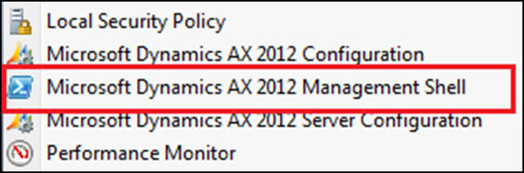
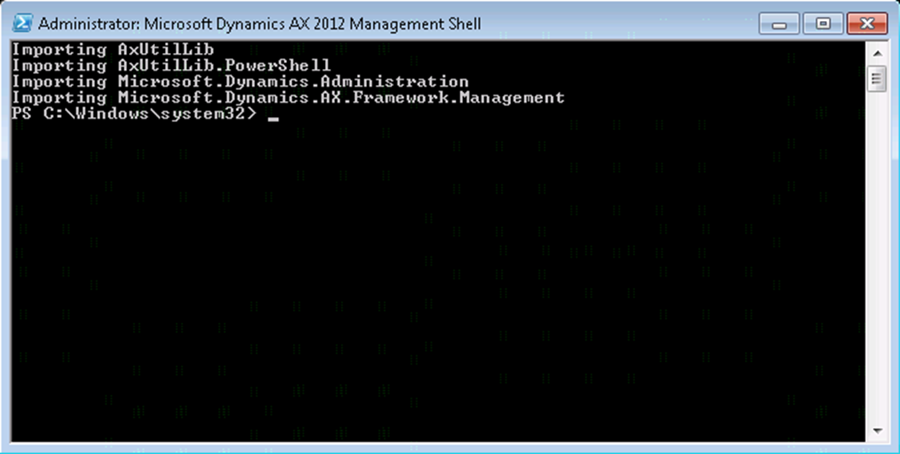
Microsoft Dynamics AX Management Shell - Getting Started
Start > Administrative Tools > Microsoft Dynamics AX 2012 Management Shell
Notes:
Important: In the following procedures, we will only use Windows PowerShell and AOT examples. Windows PowerShell and AxUtil use similar commands, so we will only demo one of them. See Appendix A for AxUtil examples.

Slide 17
Microsoft Dynamics AX Management Shell - Getting Help
List all model related cmdlets
Get-Command –Module AXUtilLib.PowerShell
Get help text for a specific cmdlet
Get-Help <cmdlet name>
Example: Get-Help New-AXModel
Or look at the help xml files directly
C:\Program Files\Microsoft Dynamics AX\60\ManagementUtilities\Modules\AXUtilLib.Powershell\AXUtilLib.Powershell.dll-Help.xml

Slide 18
Manage Models with Microsoft Dynamics AX Management Shell
Scenario: Isaac, the Application Software Developer, is new to Microsoft Dynamics AX 2012 and he wants to learn about the new Windows PowerShell cmdlets. He wants to create a new model, export it, delete it, and import it.
Procedures:
View AX Management Shell commands
Create a model using Windows PowerShell
Export a model using Windows PowerShell
Delete a model using Windows PowerShell
Import a model using Windows PowerShell
Notes:
View AX Management Shell commands
Go to Start > Administrative Tools
Right-click Microsoft Dynamics AX 2012 Management Shell, and then select Run as Administrator.
In the management shell, type the follow command:
Get-Command -Module AXUtilLib.PowerShell
Create a model using Windows PowerShell
Type the following command to see a list of all existing models in the model store:
Get-AXModel
Alternatively, you can output that same information to an interactive grid using the following command:
Get-AXModel | Out-GridView
Type the following command to see the syntax options for the New-AXModel Windows PowerShell cmdlet:
Get-Help New-AXModel
Type the following command to add the "CONTOSO" model to the user layer:
New-AXModel -Model CONTOSO -Layer Usr
Type the following command to see a list of all existing models in the model store. Notice that the "CONTOSO" model is now listed:
Get-AXModel | Out-GridView

Slide 19
Notes Continued
Notes:
Manage Models with Microsoft Dynamics AX Management Shell (continued)
Export a model using Windows PowerShell
Type the following command to export the "CONTOSO" model to a file:
Export-AXModel -Model CONTOSO -File C:\Contoso.axmodel
Delete a model using Windows PowerShell
Type the following command to see a list of all existing models in the model store:
Get-AXModel | Out-GridView
Type the following command to delete the "CONTOSO" model from the user layer, and then click Yes when you are prompted:
Uninstall-AXModel -Model CONTOSO
Type the following command to see a list of all existing models in the model store. Notice that the "CONTOSO" model is now gone:
Get-AXModel | Out-GridView
Import a model using Windows PowerShell
Type the following command to import the "CONTOSO" model into the same layer it was exported from:
Install-AXModel -File C:\Contoso.axmodel -Conflict Reject
Type the following command to see a list of all existing models in the model store:
Get-AXModel | Out-GridView

Slide 20
Manage Models Using AOT
Scenario: Isaac, the Application Software Developer, is new to Microsoft Dynamics AX 2012 and he wants to learn how to manage models using the AOT. He wants to create a new model, add a form to a model, show all elements in a model, and move an element to a different model.
Procedure: Create a model using AOT
Procedure: Add a form to a model using AOT
Procedure: Show all elements in a model using AOT
Procedure: Move element to different model using AOT
Notes:
Procedure: Create a Model Using AOT
To create a new model from the AOT, follow these steps:
Open a New Development Workspace.
Select Tools > Model management > Models installed from the main menu to see which models are currently installed. Review the list of models, and then click Close.
Select Tools > Model management > Create model from the main menu.
Model Name: ContosoOrderEntry.
Model Publisher: Contoso IT.
Layer: Usr.
Model Description: Contoso order entry customizations.
Model Display Name: ContosoOrderEntry.
Click OK.
Procedure: Add a Form to a Model Using AOT
To add a form to a model from the AOT, follow these steps:
Within the Development Workspace, select Tools > Options from the main menu.
Click Development from the options at the left of the screen. Under the Application Object Tree heading, select the following options:
Application object layer: Show all layers.
Application object model: Show on all elements.
Click Status bar from the options at the left of the screen. Select the Show current model option. Click Close.
In the Status bar, double-click the current model.
Select ContosoOrderEntry, and then click OK. Notice the current model has changed.
In the AOT, right-click Forms, select New form and name it ContosoForm. Notice this object was created in the current model and layer displayed in the status bar.

Slide 21
Notes Continued
Notes:
Manage Models Using AOT (continued)
Procedure: Show all Elements in a Model Using AOT
To add a form to a model from the AOT, follow these steps:
Within the Development Workspace, select Tools > Model management > Model elements from the main menu to all elements in the model store.
Right-click the Model column for one of the rows of data, and then select Filter by field to filter by the model display name.
Type ContosoOrder* to list all of the elements for the ContosoOrderEntry model.
Notice that a simple form actually consists of multiple elements in the model, such as the FormDataSource, FormMethod, and different security levels.
Procedure: Move Element to Different Model Using AOT
To move the ContosoForm form from the ConosoOrderEntry model to the USR Model, follow these steps:
Within the Development Workspace, navigate to AOT > Forms.
Right-click ContosoForm, and then select Move to Model.
Select USR Model, and then click OK.
Notice that the form is now in USR Model.

Slide 22
Lab 5.1: Export Model Store Using Microsoft Dynamics AX Management Shell
Lab Scenario: Chris, the IT Engineer, needs to export the model store from his pre-production instance to a file so it can be imported into the production instance during an upcoming maintenance window.
Notes:
To export the entire model store to a file, follow these steps:
Go to Start > Administrative Tools.
Right-click Microsoft Dynamics AX 2012 Management Shell, and then select Run as Administrator.
Type the following command to export the model store (5 minutes to run, generates ~2 GB file):
Export-AXModelStore -file C:\ContosoModelStore.axmodelstore -Server AX2012-A -Database MicrosoftDynamicsAX -Details -verbose

Slide 23
Code Deployment Options
Export/import using:
.xpo file (same as Microsoft Dynamics AX 2009)
model file (new in Microsoft Dynamics AX 2012)
model store file (new in Microsoft Dynamics AX 2012)
Notes:
As part of the Microsoft Dynamics AX 2012 application life cycle, every implementation should include several separate environments to reliably control what code ends up running on the customer’s production system.
This section describes best practices for moving Microsoft Dynamics AX 2012 customizations into the production environment, while minimizing downtime.
This section assumes that customers and partners are running a system that has the following characteristics:
Test or pre-production environments are built based on the production environment.
Modifications are applied first to test or pre-production environments, and then tested.
Modifications are then deployed to the production environment.

Slide 24
Code Deployment Comparison
Description | XPO files | Model files | Model store files
Imported/exported by using… | MorphX | AXUtil.exe or Windows PowerShell cmdlets | AXUtil.exe or Windows PowerShell cmdlets
Can be uninstalled? | No | Yes | No
Can be signed? | No | Yes | No
Microsoft Dynamics AX Object IDs from source environment preserved? | No* | No* | Yes
Compile required? | Yes | Yes | No
CIL Generation required? | Yes | Yes | No
Notes:
Metadata can be moved by using export/import files (XPOs), models, or by moving the entire model store at the same time. There are advantages and disadvantages to each approach.

Slide 25
Code Deployment Considerations
All IDs are now installation-specific.
Use .xpo or model files to move code in dev/test environments.
When you change an existing element via an .xpo file, it applies it to the highest layer of the element and not to the current MorphX layer. If you want to update middle layers, you need to use model files instead.
Use /conflict:reject or /conflict:push instead of /conflict:overwrite when elements collide.

Slide 26
More Code Deployment Considerations
When making changes to an existing model, overwrite it instead of uninstalling/reinstalling to maintain consistent IDs.
Install models from lowest to highest layer.
Models will always be installed in the same layer they were originally exported from.
Use backup of production database to initialize the staging environment, and then import models from test.
To move code to production, export the model store from staging and import it to production.

Slide 27
Recommended Reading
Microsoft Dynamics AX 2012 White Paper: Deploying Customizations Across Microsoft Dynamics AX 2012 Environments
http://www.microsoft.com/en-us/download/details.aspx?id=26571
Maintaining Installation-Specific Elements IDs and Element Handles [AX 2012]
http://technet.microsoft.com/en-us/library/hh352326.aspx

Slide 28
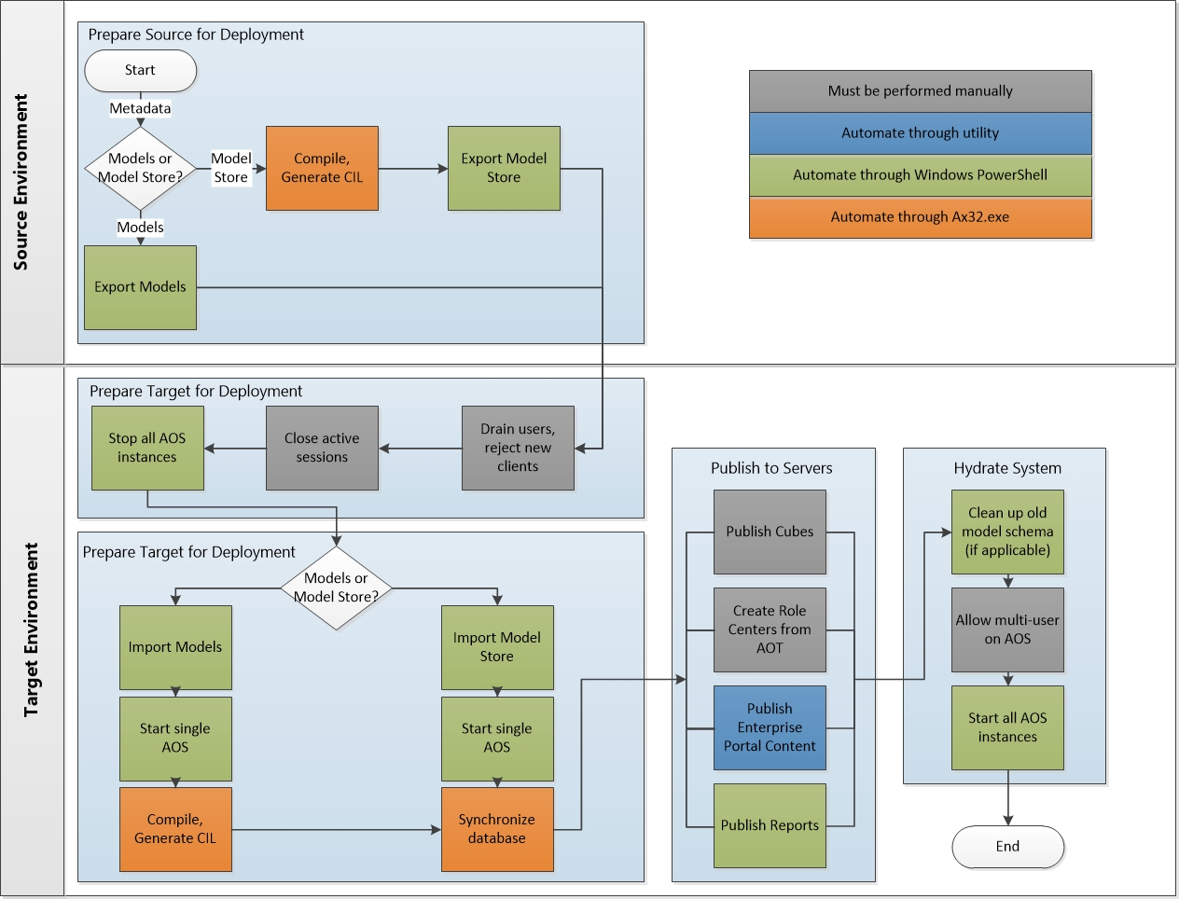
Code Deployment Process: Using Model Store
Notes:
Recommended Code Deployment Process
The recommended process for deploying customizations is (detailed instructions are following):
Ensure that the source system is ready for export.
Export from the source environment.
Prepare the target environment for deployment.
Import to the target system.
Finalize the deployment.
Tip: To avoid element ID conflicts later on, it is essential that the target database (especially in production) is initialized from an exported source database—not individual model files.
Ensure that the source system is ready for export
To properly ensure that the source system is ready for export, follow these steps:
Grant necessary permissions to the deployment account
Re-import all web content into the AOT
Compile the application and generate CIL
Export from the source environment
After the source environment is ready for export, the metadata, workflows, integration ports, and any other necessary data can be exported from the source system.
Export metadata
Export workflows from source environment
Export integration ports from source environment

Slide 29
Notes Continued
Notes:
Code Deployment Process Using Model Store (continued)
Prepare the target environment for deployment
Grant necessary permissions to the deployment account
Drain active users and reject new clients
Remove any active users
Stop all AOS’s in the target environment
Import to the target system
Copy all deployment artifacts to the target environment
Import metadata to the target environment
Start Microsoft Dynamics AX 2012 for maintenance
Synchronize the database, if necessary
Create Role Centers from the AOT
Deploy web content
Import workflows into the production environment
Correct workflows (if you are using XPOs or models)
Import integration ports into production environment
Deploy cubes
Deploy reports
Finalize the deployment
Clean up the old metadata schema
Set the AOS instance to re-accept clients

Slide 30
Code Deployment Process: Using Models
Key Differences

Slide 31

Minimizing Downtime for Model Store Deployments
Use parallel schemas
(model stores)
Create temp schema
Import new model store from a file into temp schema
Stop AOS (downtime starts)
Rename temp schema to dbo, start single AOS, synchronize database
Start all AOS, allow users. (downtime over)
AX Database
dbo
(operational)
model store
Temp
(empty)
model store
dbo
(operational)
model store
Temp
(idle)
model store
Contoso.axmodelstore

Slide 32
Lab 5.2: Import Model Store Using Microsoft Dynamics AX Management Shell
Lab Scenario: Chris, the IT Engineer, needs to import the model store file into the production instance and wants to minimize downtime.
Notes:
The steps for importing the new model store can be done before users are drained. Follow these steps:
Go to Start > Administrative Tools
Right-click Microsoft Dynamics AX 2012 Management Shell, and then select Run as Administrator.
Run the schema command to create a new schema:
Initialize-AXModelStore -SchemaName MyTempSchema -Database MicrosoftDynamicsAX –Verbose
Import the model store into the temporary schema (5 minutes to run):
Import-AXModelStore -File C:\ContosoModelStore.axmodelstore –SchemaName MyTempSchema -Database MicrosoftDynamicsAX –Verbose
When all users are out of the system, stop the AOS instance.
Move the model store that has been imported into the MyTempSchema schema to the default schema (dbo) (5 seconds to run):
Import-AXModelStore -Apply MyTempSchema -Database MicrosoftDynamicsAX –Verbose

Slide 33
Test Your Knowledge
The class will complete this section

Slide 34
Chapter Review
Where is code stored in Microsoft Dynamics AX 2012 (Select all that apply.)
( ) SQL Server
( ) Model store
( ) Application files
( ) AOS
Which tools are used to manipulate Microsoft Dynamics AX Models? (Select all that apply.)
( ) Graphical user interface
( ) AxUtil.exe
( ) Programming logic
( ) Microsoft Dynamics AX 2012 Server Configuration

Slide 35
Chapter Review (Answers)
Where is code stored in Microsoft Dynamics AX 2012 (Select all that apply.)
(X) SQL Server
(X) Model store
( ) Application files
(X) AOS
Which tools are used to manipulate Microsoft Dynamics AX Models? (Select all that apply.)
(X) Graphical user interface
(X) AxUtil.exe
(X) Programming logic
( ) Microsoft Dynamics AX 2012 Server Configuration

Slide 36
Chapter Summary
In this chapter, we covered the following topics:
The model store architecture
How to manage models and the model store
Code deployment options and best practices

